Slide 1
SCHOLARBRIDGE
Scholarship Finder for Students
Team Members :
Student Name | Register Number | Student Name | Register Number
Madhur Sanjay S | 310626104186 | Nethra Sabhanayagam | 310626104216
Mihir Kiran K | 310626104196 | Nishandhan P S | 310626104226
Monisha Bobby J | 310626104206 | Pooja S | 310626104236
Department & Section : CSE I – ‘D’
Subject Code : 2321CSS103J
Subject Name : WEB ESSENTIALS

Slide 2
Table of contents
Objective / Project Goal
Proposed Solution
Tools & Techniques
Workflow / Architecture Diagram
Expected Outcomes
Real-world Applications
Challenges Faced
Results / Demo Screenshots
Future Scope
Team Contributions

Slide 3
Objective / Project Goal
Goal: help students find scholarships easily in one place.
Show the scholarship name, provider, amount, level and category on simple cards.
Objectives:
  Search and filter by education level and category.
  Suggest matching options with the eligibility finder.
  Guide students to official portals and deadline reminders.

Slide 4
Proposed Solution
Solution: ScholarBridge, a student-friendly scholarship finder webpage.
Input: a keyword in the search box, or a study level and category.
Process: JavaScript checks every scholarship card and keeps only the matches.
Output: matching cards with provider, amount, deadline tip, an official link and a result count.

Slide 5
Tools & Techniques
Tools / Platforms Used
Code editor (such as VS Code)
Web browser (Chrome / Edge) to test the page
National Scholarship Portal for official links
Programming Languages
HTML5: header, nav, section, article, form
CSS3: Grid, Flexbox, variables, media queries
JavaScript: search, filters, Save button, form events

Slide 6
Workflow / Architecture Diagram
Input → Processing → Output
INPUT
Search text
Study level
Category / priority
PROCESSING
JavaScript filterCards()
Checks title, level, category
Updates the count
OUTPUT
Matching scholarship cards
Result count
Official portal links
Main modules of the page :
Navigation bar
Hero section
Search + filters
Scholarship cards
Save button
Eligibility finder
Three-step guide
Reminder tip

Slide 7
Expected Outcomes
The page lists scholarship cards and shows a live count, such as “Showing 5 opportunities”.
Example: Undergraduate + Need-based shows 5 matching cards, and Save turns into Saved.
It helps students save time, keep options organised and reach the official portal to apply.

Slide 8
Real-world Applications
Practical use: a scholarship help page for schools, colleges and counselling centres.
Who can benefit: school, undergraduate and postgraduate students and their parents.
Community use: NGOs and college scholarship cells can guide students to official portals.

Slide 9
Challenges Faced
Using search, level and category together: one function checks all three for every card.
Neat layout on phone and laptop: CSS Grid, Flexbox and media queries.
Scholarship details change often: official links and “check current notice” labels.
Learning: JavaScript events can update the page instantly, without reloading.

Slide 10
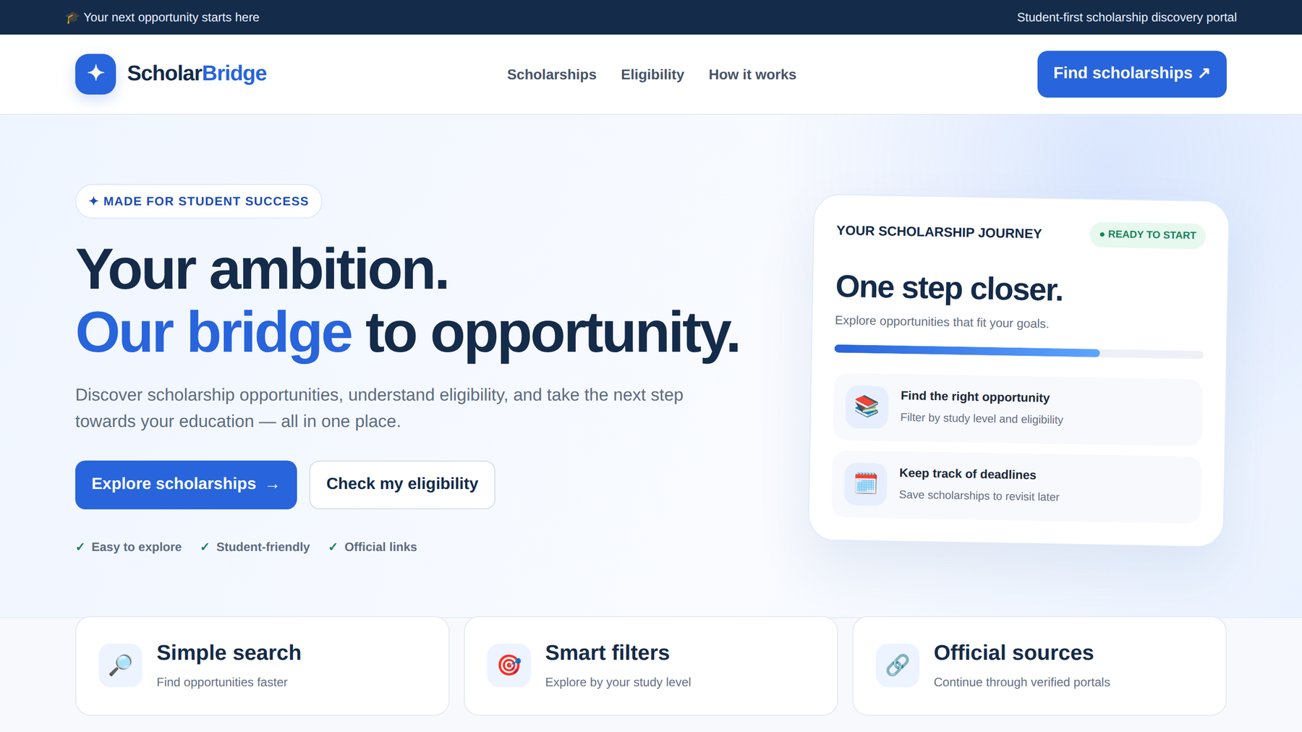
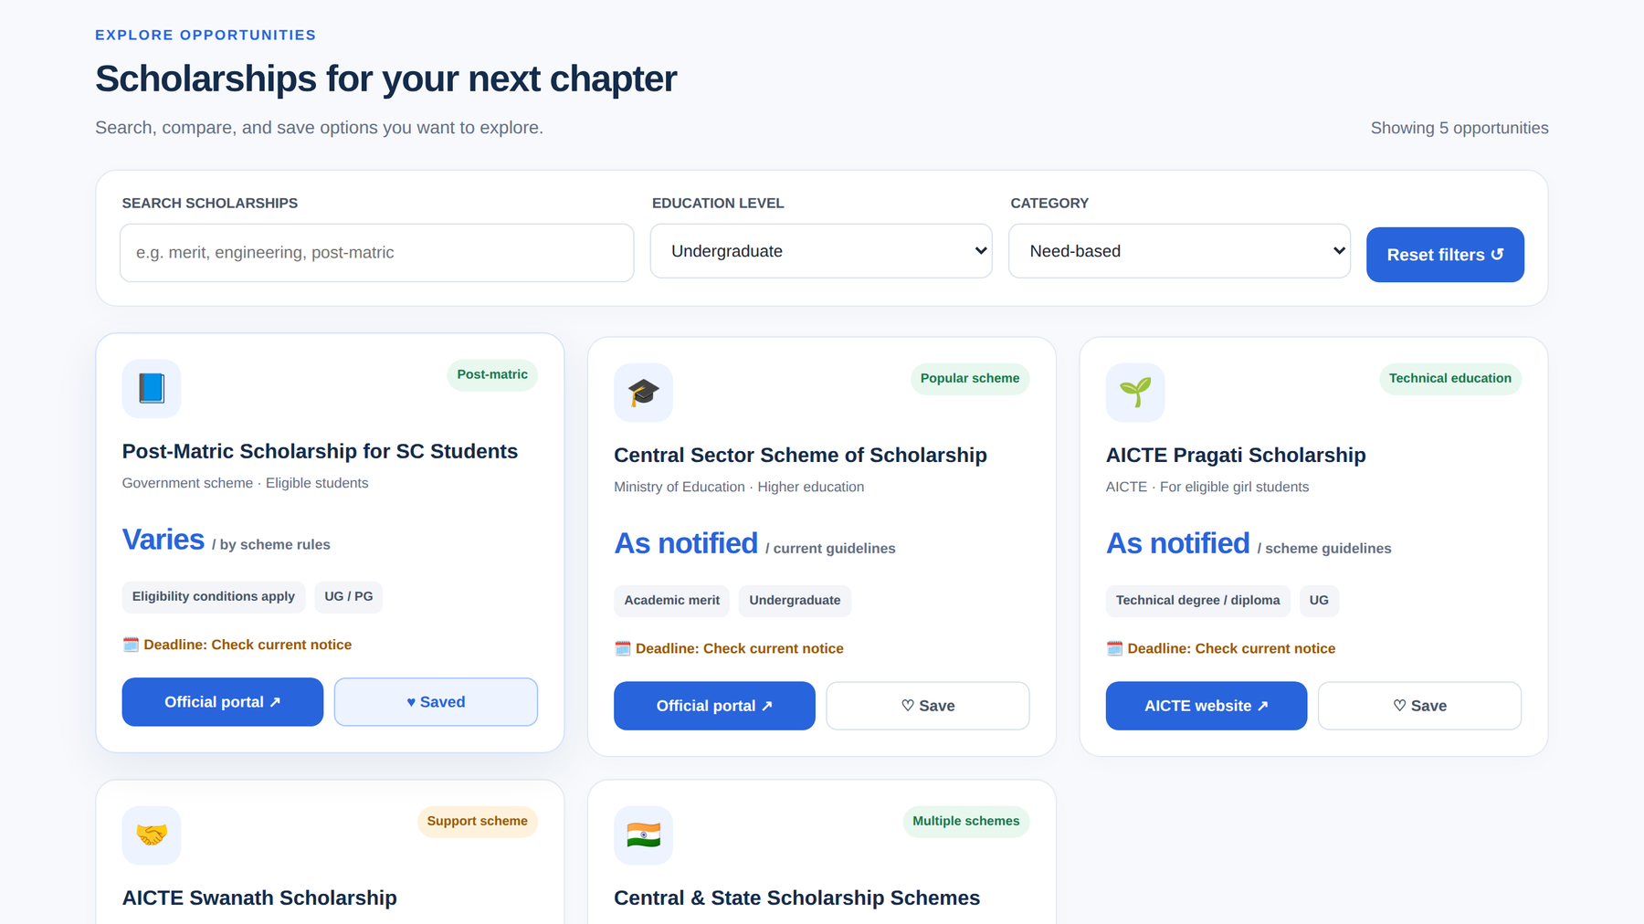
Results / Demo Screenshots
Home page
Top bar, navigation, hero buttons and three highlight cards.
Search and filters
Undergraduate + Need-based gives 5 results; one card is saved.

Slide 11
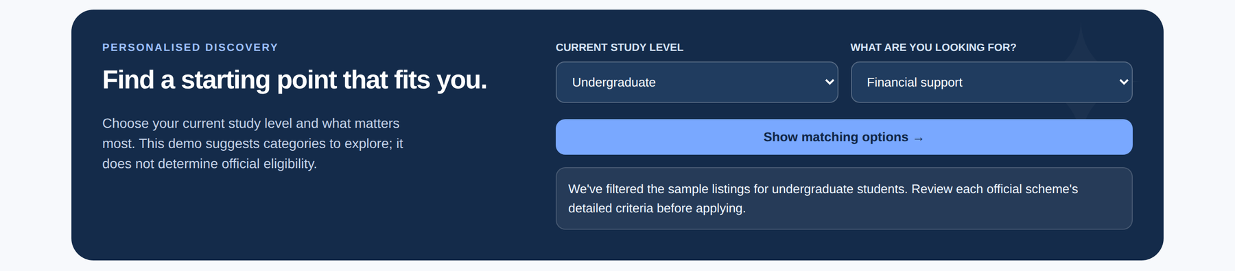
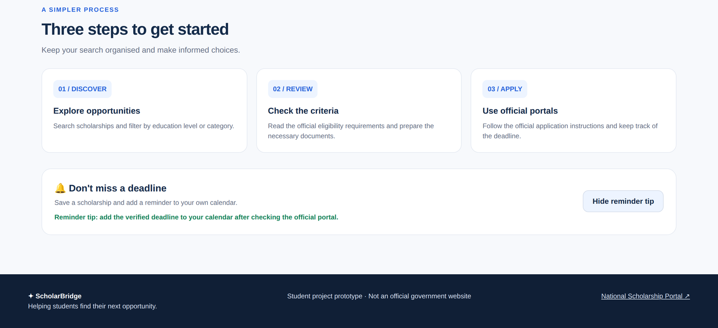
Results / Demo Screenshots
Eligibility finder: choose a study level and a need, then the cards are filtered automatically.
Steps, reminder and footer
Discover, Review and Apply guide.
Reminder tip opens and closes on click.
Footer links to the National Scholarship Portal.

Slide 12
Future Scope
Use a real scholarship database with up-to-date amounts and deadlines.
Add a student login so saved scholarships stay after the page is refreshed.
Send calendar or email reminders before deadlines.
Add more filters (state, income, gender) and regional language support.

Slide 13
Team Contributions
Member | Role / Work Done
Madhur Sanjay S | HTML structure: header, hero, sections and footer
Mihir Kiran K | CSS: layout with Grid and Flexbox, colours, responsive design
Monisha Bobby J | JavaScript: search, filters and result count
Nishandhan P S | Save button and eligibility finder form
Pooja S | Scholarship content, official links and testing
Nethra Sabhanayagam | Screenshots, PPT and documentation

Slide 14
Thank You!
Questions are welcome. We are ready for a live demo.

